Slide 1
Densely Connected Convolutional Networks
Gao Huang, Zhuang Liu, Kilian Q. Weinberger,
Laurens van der Maaten

Slide 2
Brief Introduction
DenseNet (Dense Convolutional Network) connects layers in a feed-forward fashion.
DenseNet with L layers has L*(L+1)/2 direct connections between each layer and its subsequent layer.
Advantages: Alleviate the vanishing-gradient problem
Strengthen feature propagation
Encourage feature reuse
Reduce the number of parameters substantially
Evaluation Dataset: CIFAR-10, CIFAR-100, SVHN, Imagenet
Project Code: https://github.com/liuzhuang13/DenseNet

Slide 3
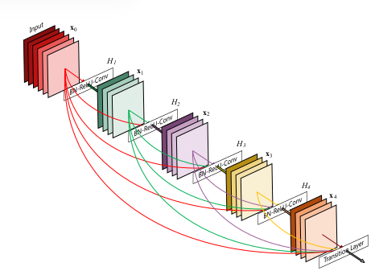
Brief Introduction
DenseNet
A 5-layer dense block
with a growth rate of
k = 4. Each layer takes
all preceding feature-
maps as input.

Slide 4
DenseNets Config
Dense Connectivity
Direct connections from any layer to all subsequent layers----
l^{th} layer receives the feature-maps of all preceding layers, x₀, .. , x^{l-1} , as input:
x_{l} = H_{l} ([x₀, x₁, ... , x_{l-1} ])
where [x₀, x₁, ... , x_{l-1} ] refers to the concatenation of the feature-maps produced in layers 0, ... , l-1.

Slide 5
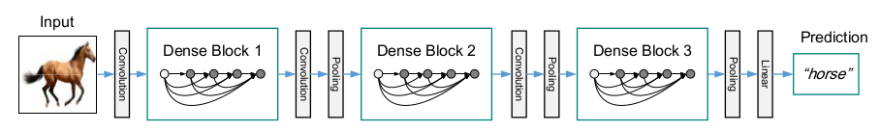
DenseNets Config
Pooling Layers
Divide the network into multiple densely connected dense blocks----
A deep DenseNet with three dense blocks. The layers between two adjacent blocks are referred to as transition layers and change feature map sizes via convolution and pooling.

Slide 6
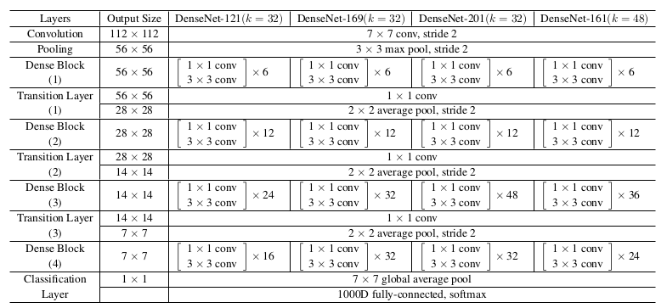
DenseNets Architecture
The growth rate for the first 3 networks is k = 32, and k = 48 for DenseNet-161.

Slide 7
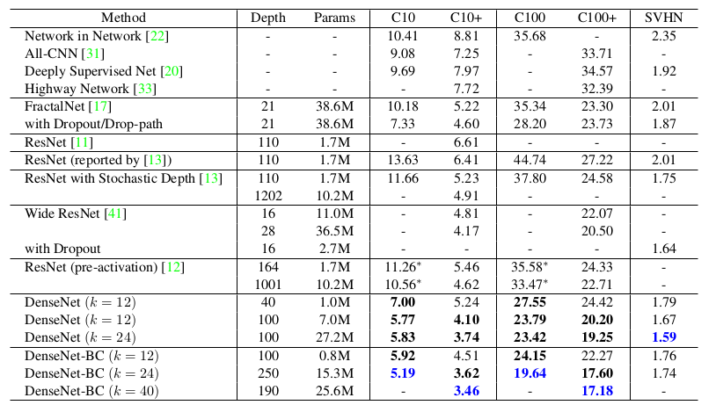
Experiments Results
Error
rates
(%)
on
CIFAR
and
SVHN
datasets.

Slide 8
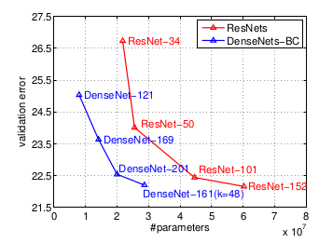
Experiments Results
Comparison of the
DenseNet and Res-
Net Top-1 (single
model and single-
crop) error rates
on the ImageNet
classification data-
set as a function
of learned para-
meters during test-
time.

Slide 9
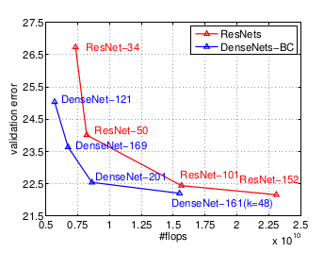
Experiments Results
Comparison of the
DenseNet and Res-
Net Top-1 (single
model and single-
crop) error rates
on the ImageNet
classification data-
set as a function
of learned flops
during test-time.

Slide 10
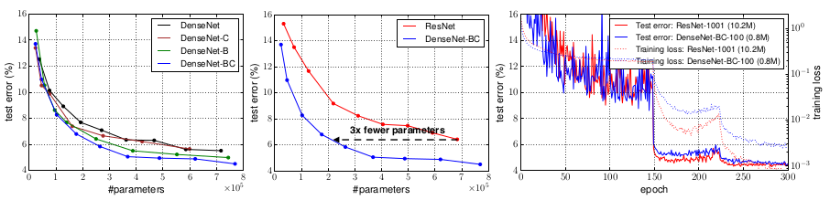
Experiments Results
Left: Comparison of the parameter efficiency on C10+ between DenseNet variations.
Middle: Comparison of the parameter efficiency between DenseNet-BC and (pre-activation) ResNets. DenseNet-BC requires about 1/3 of the parameters as ResNet to achieve comparable accuracy.
Right: Training and testing curves of the 1001-layer pre-activation ResNet [12] with more than 10M parameters and a 100-layer DenseNet with only 0.8M parameters.

Slide 11
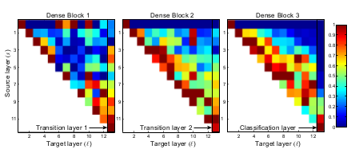
Experiments Results
The average absolute filter weights of convolutional layers in a trained DenseNet. The color of pixel (s, l) encodes the average L1 norm (normalized by the number of input feature maps) of the weights connecting convolutional layer s to layer l within a dense block.

